Slide 1
KPMG
Internship task 3 Data Visualisation
Stuti Bimali

Slide 2
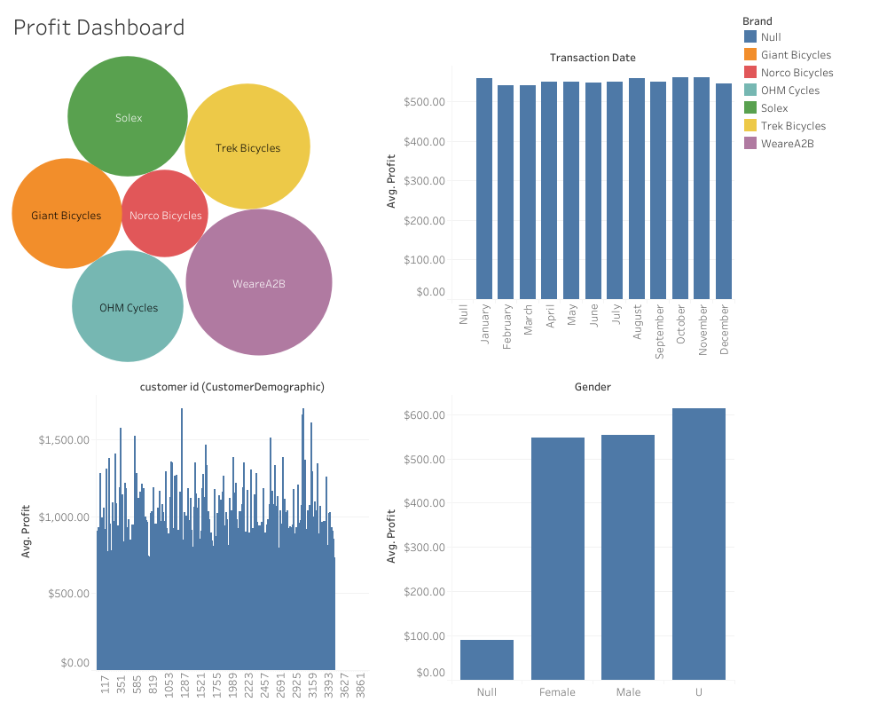


Slide 3

Thank
You

